Slide 1
Introduction to Programming with Python
Vineet Bansal
Research Software Engineer, Center for Statistics & Machine Learning
vineetb@princeton.edu
August 20-24, 2018

Slide 2
Why Python?
Sky-rocketed in popularity in the last decade.

Slide 3
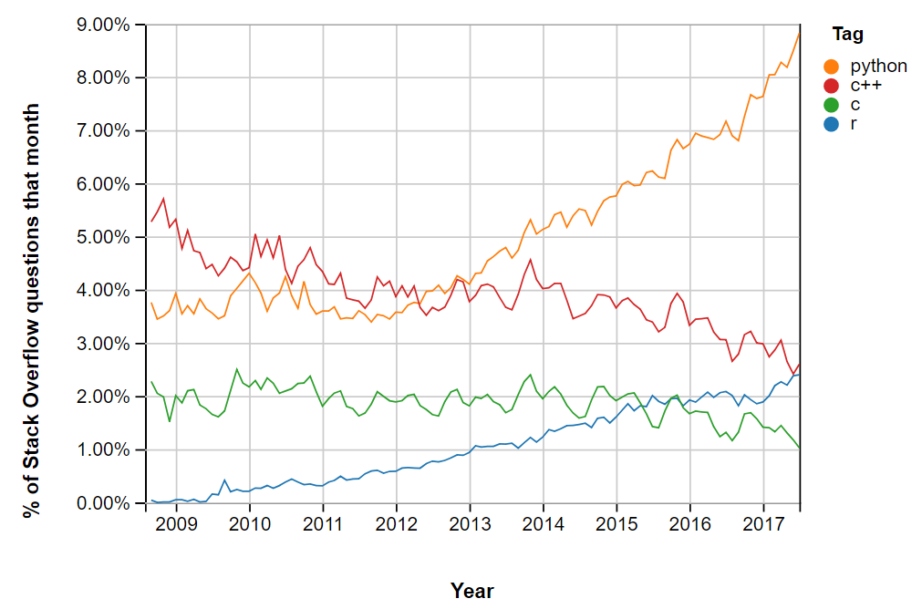
StackOverflow Trends
https://insights.stackoverflow.com/trends

Slide 4
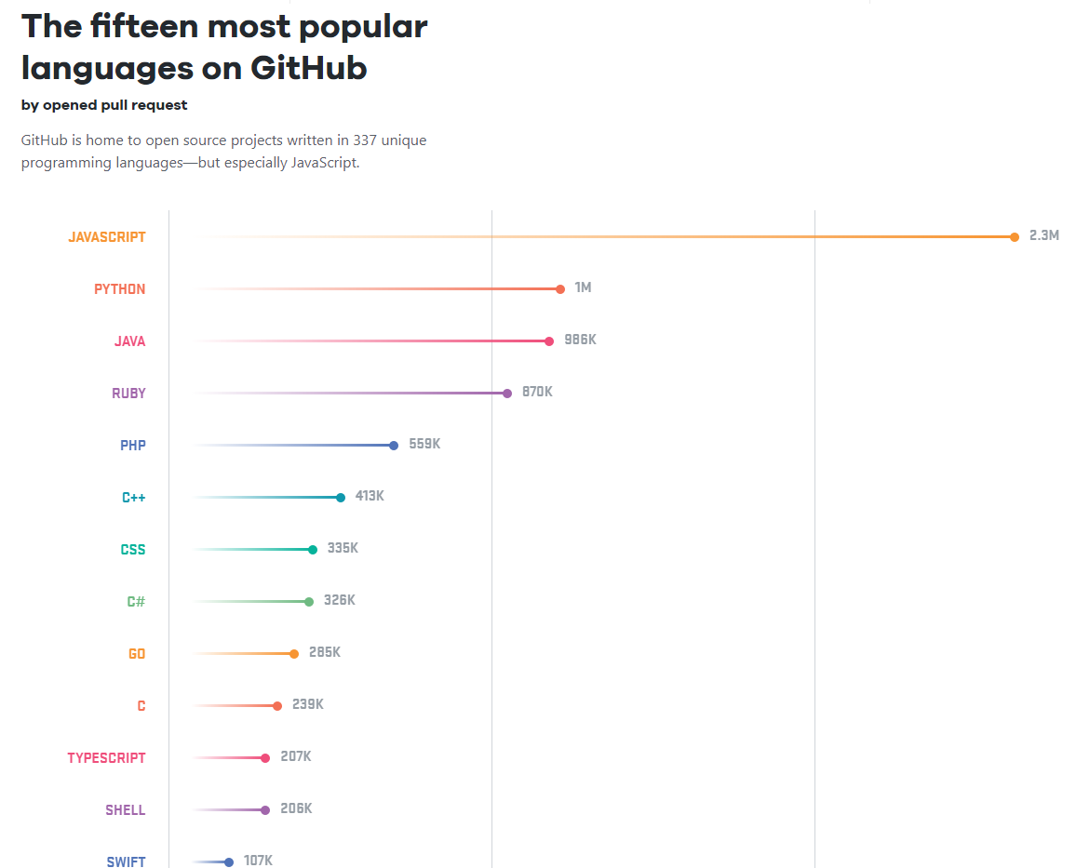
GitHub Trends

Slide 5
Why Python?
Sky-rocketed in popularity in the last decade.
High-level, general purpose
Web Development
Django, Flask, JSON, Email processing, Network programming
Scientific and Numeric Computing
Numpy, SciPy, Pandas, Ipython
Cross-platform Desktop App Development
wxPython, wxWidgets, pyside
Data manipulation & Plotting
Pandas, Matplotlib
Machine Learning & Deep Learning
Scikit-learn, Tensorflow, PyTorch
Extensive Support Libraries

Slide 6
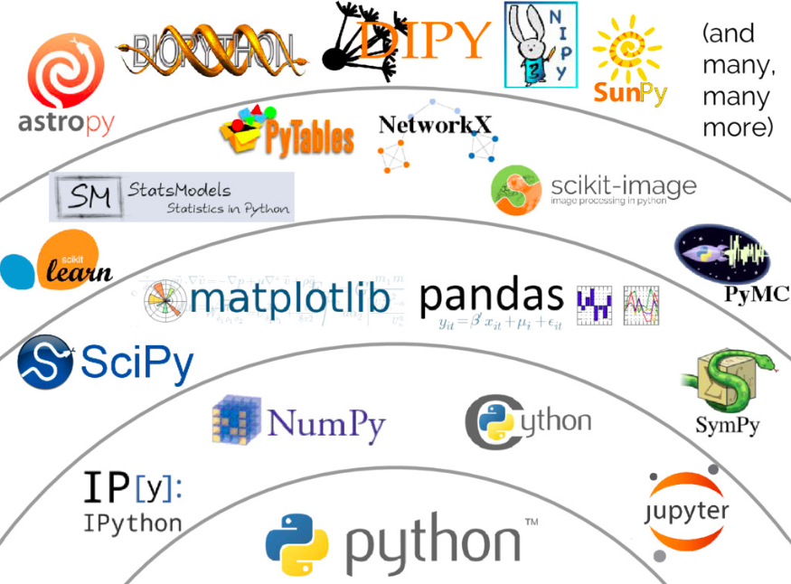
Python Ecosystem

Slide 7
Why Python?
Sky-rocketed in popularity in the last decade.
High-level, general purpose
Web Development
Django, Flask, JSON, Email processing, Network programming
Scientific and Numeric Computing
Numpy, SciPy, Pandas, Ipython
Cross-platform Desktop App Development
wxPython, wxWidgets, pyside
Data manipulation & Plotting
Pandas, Matplotlib
Machine Learning & Deep Learning
Scikit-learn, Tensorflow, PyTorch
Extensive Support Libraries
Increased Programmer’s Productivity
Expressive, hence less programming
Reads like pseudocode
Encourages DRY (Don’t repeat yourself)

Slide 8
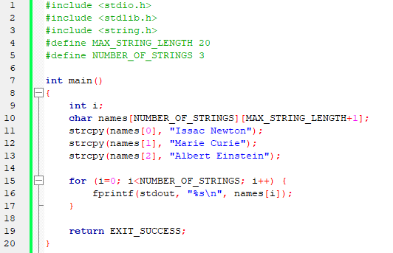

Compare the following snippets of code
C
Python
→

Slide 9
Why Python?
Sky-rocketed in popularity in the last decade.
High-level, general purpose
Web Development
Django, Flask, JSON, Email processing, Network programming
Scientific and Numeric Computing
Numpy, SciPy, Pandas, Ipython
Cross-platform Desktop App Development
wxPython, wxWidgets, pyside
Data manipulation & Plotting
Pandas, Matplotlib
Machine Learning & Deep Learning
Scikit-learn, Tensorflow, PyTorch
Extensive Support Libraries
Increased Programmer’s Productivity
Expressive, hence less programming
Reads like pseudocode
Encourages DRY (Don’t repeat yourself)
Corporate Backing as of 2018
Official Language of Google since its inception.
Finance Industry (NYC, $$$)
Microsoft, Amazon, Facebook, all heavily use it.

Slide 10
Limitations
Interpreted → Slower
Most performance-critical parts are written in C/C++
Tensorflow/Numpy/Scipy etc.
Fewer restrictions on the developer → Run-time Errors
Quick to develop, requires more testing
(Currently) weak in Mobile Computing

Slide 11
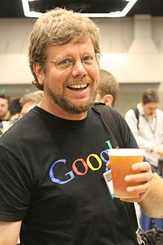
Brief History
Started in 1989, made public in 1991
Dutch programmer – Guido van Rossum (“Benevolent Dictator for Life”)
Google, Dropbox
Python 3 has been around for nearly 10 years now. We’ll stick to Python 3!

Slide 12
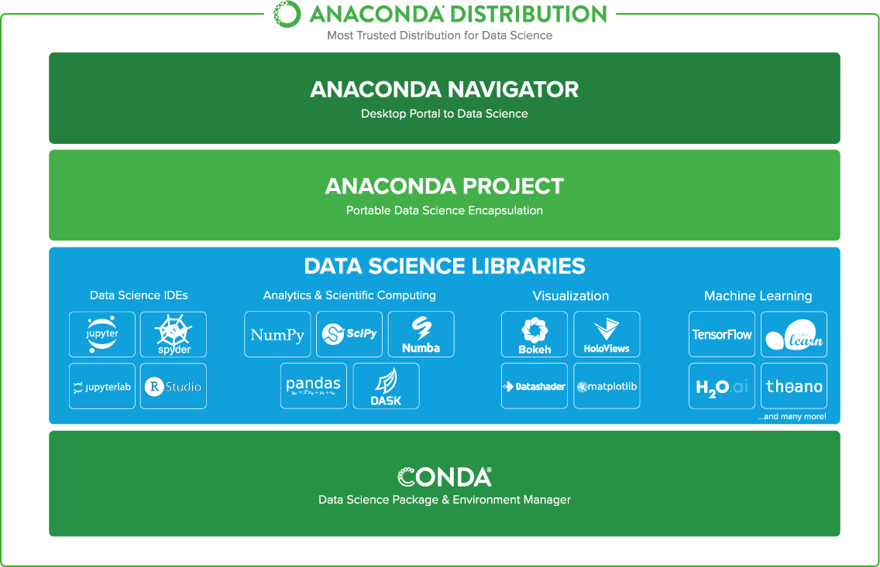
Let’s get started!
Download and install the Anaconda Distribution
https://www.anaconda.com/download
Python 3.6, 64-bit Graphical Installer
Let’s see how …

